Slide 1
CUSTOMER
PREDICTION

Slide 2
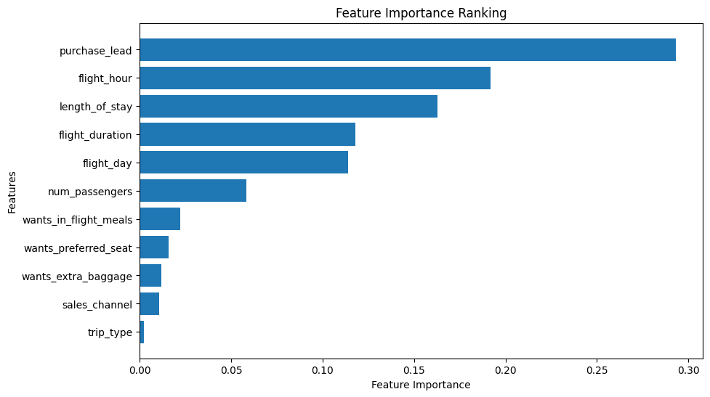
Results
The purchase_lead was the primary feature in the model, that is the time between purchase date and departure date.
Information about the flight, like flight _hour, length_of_stay, flight_duration and flight_day was also primary features.
But booking origin of the customer was not so important.
The accuracy of the model was approximately 0.852 (Precision). Although It was a good result .It can be still be more accurate if it has more customer behavior oriented features

